Slide 1

Managing Stress Resources
Dessi Beagle (Tzankova), Your Employee Wellness Coordinator

Slide 2
Objectives
Discuss the common symptoms of stress
• Provide strategies for identifying and managing stress
Learn practical tips and techniques to manage current stressors with resources through USG
Band workout

Slide 3
Disclaimer
The information provided is not intended to be a substitute for professional medical advice, diagnosis or treatment. Never disregard professional medical advice, or delay in seeking it, because of information presented in this workshop. Never rely on information in the workshop in place of seeking professional medical advice.
Guest speakers (KSU) are not responsible or liable for any advice, course of treatment, diagnosis or any other information, that you obtain through the Hoot for Health Program. You are encouraged to consult with your doctor with regard to this information presented during the program. Hoot for Health Program speakers ARE NOT MEDICAL DOCTORS. The information we provide is based on thorough years of studies in our respective health-related disciplines & our experience as professionals. Any recommendations we make about weight training, nutrition, metal health or lifestyle should be discussed between you & your doctor because any changes in your regimen may be detrimental.

Slide 4
How “Well” Are You?
What does wellness look like?
    Social wellness
    Emotional wellness
    Spiritual wellness
    Environmental wellness
    Occupational wellness
    Intellectual wellness
    Physical wellness
    Creative wellness
    Financial wellness

Slide 5
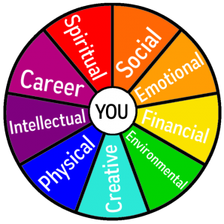
A Balanced “Wheel of Wellness”

Slide 6
Gaps in Wellness
What does it mean if your wheel isn’t balanced?
  Something is missing
  There are hurdles
  This can produce stress

Slide 7

Why Do We "Stress Out"?
For two major reasons:
  We perceive a situation as dangerous, difficult, or painful.
  We don't believe we have the resources to cope.
Notes:
Our Perceptions = How Stressed We Feel
We often identify specific events, people, or situations that seem to make us feel stressed. It's as if these things automatically cause us feel stressed out. In reality, it's how we perceive an event, the meaning we give to it, that leads us to feel stressed or not stressed about it.
The interesting thing about stress is that it begins with our own perceptions of things!
Have you ever noticed that some people can feel quite stressed out about a particular event while others don't seem to be bothered by it at all? For instance, if three of your friends all get a poor grade on a test, you might notice some different reactions. One friend may seem mildly annoyed for an hour or so. Another friend doesn't seem to be bothered at all. The third friend, however, might become quite alarmed by this poor grade. She can't get it off her mind, she vows to study three times as hard next time, she can't concentrate on her other work, and she might even find it difficult to fall asleep that evening. She might become increasingly concerned about all the grades she'll make this semester, and wonder whether her GPA will suffer.
In a case such as this, a poor grade on a test means something different for each of your friends. The same situation has happened to all three, but each person feels more or less stressed about it because of what it means to him or her.

Slide 8
What is Stressful to You?
Work | Roommate | Legal matters
Classes | Childcare | Mental health
Studying | Finances | Law violation
Relationship with partner | Appearance | Spiritual/Religious issues
Relationship with family | Physical Health | Major/Career decisions
Relationship with friends | Not “fitting in” | Attitudes/thoughts
Trauma | Getting married | Buying a house
Change in residence | Change to a new school | Change in amount of recreation
Change in amount of social activities | Change in eating habits | Death of friend/family member

Slide 9
Why Stress Is Important
The role of stress in cardiac health
  Long-term stress has been related to 1.5x excess risk of developing coronary heart disease.
  Acute and chronic stressors increase cardiovascular disease risk and progression by affecting the immune system, endocrine system, and metabolism

Slide 10
Why Stress Is Important
The impact of stress on all of us (cont’d)
  40% of stressed people overeat
  31% of adults report skipping a meal due to stress (APA stats)
  44% of stressed people lose sleep every night
  Stress can cause us to lose patience with other, be short, or yell at others

Slide 11
Why Stress Is Important
  Extreme stress (divorce, job loss) can actually shrink the gray matter in the brain in areas tied to emotional and physiological functioning
  Stress related ailments cost the United States $300 billion per year in medical bills & lost productivity

Slide 12
What IS Stress?
A psychological and physical response of the body that occurs whenever we must adapt to changing conditions, whether those conditions be real or perceived, positive or negative. (AlleyDog Psychology Glossary Stress. (n.d.). Retrieved April 7, 2017 from the AlleyDog Wiki https://www.alleydog.com/glossary/definition.php?term=Stress)

Slide 13
Why Stress Is Important
The impact of stress on all of us
  44% of Americans feel more stressed than they did 5 years ago
  1 in 5 Americans experiences extreme stress (heart palpitations, shaking, depression)
  3 out of 4 doctors’ visits are for stress-related ailments
  Stress is the basic cause of 60% of all human illness and disease

Slide 14
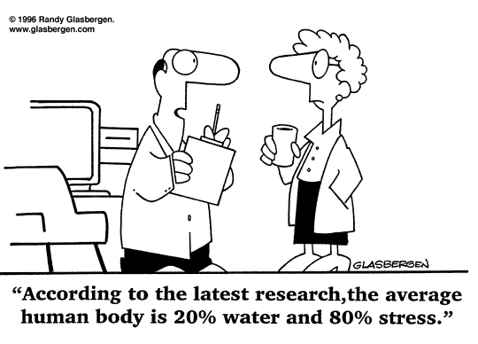
Where Does Stress Come From?

Slide 15
Examples of Stress
Stress can be thought of as big, one-time, negative events
  Losing a job
  Getting divorced
  Death in the family
  Major health crisis
Stress can also be thought of as daily hassles
  Traffic
  Getting the errands done
  Misplacing something
  Filling out forms

Slide 16
Is Stress Good or Bad?
Well… Both
Stress can help us
  Motivates us
  Protects us
  Provides an adrenaline rush
But good or bad, it was intended as a short term experience….

Slide 17
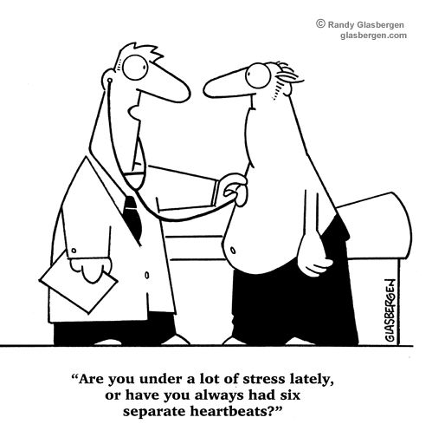
What Can Stress Do To Us?

Slide 18
Physical Symptoms
Perspiration
Racing heart
Shaking
Nervous tics
Butterflies
Nausea/Diarrhea
Sleep problems
Headaches

Slide 19
Emotional Symptoms
Moodiness
Anxiety
Short Temper
Irritability

Slide 20
Cognitive Symptoms
Low self-esteem
Fear of failure
Difficulty concentrating
Worrying about things
Forgetfulness
Preoccupation/rumination

Slide 21
Behavioral Symptoms
Stuttering
Crying for no reason
Impulsivity
Nervous laughter
Increase in smoking or drinking
Grinding teeth
Overeating

Slide 22
Why Does Stress Work This Way?
Fight or Flight reflex
  Based in the sympathetic nervous system
  Produces symptoms like a racing heart, pupil dilation, rapid breath, tense muscles
Also produces cortisol
  Called “the stress hormone”

Slide 23
Impact of Cortisol
Without a release, causing a shut-off of cortisol production, cortisol will build-up in the blood
This happens with chronic stress
Results
  Interferes with immune system
  Decreases our ability to think
  Can increase weight gain
  Can negatively impact blood pressure, cholesterol, and heart disease
  Increases risk of depression & anxiety

Slide 24
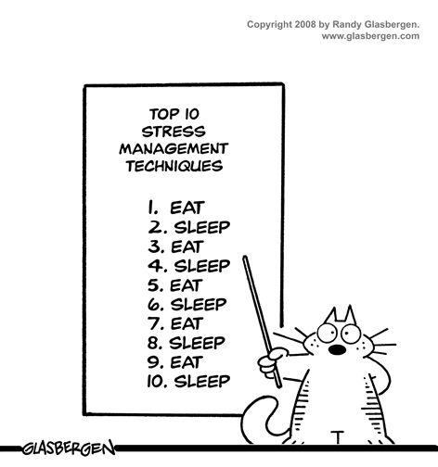
Okay, Stress Is Bad. But What Can We Do About it?

Slide 25
Step One: Try to Decrease Amount of Stress in Your Life
Think of the Four A’s
  Alter
  Avoid
  Adapt
  Accept

Slide 26
Four A’s
Alter your life to Avoid stress
  Cut back - Organize
  Delegate - Streamline
Alter your thoughts to Adapt
  Changing thoughts to change feelings
Accept
  Don’t fight what can’t be changed
  Build the ability to be in the moment

Slide 27
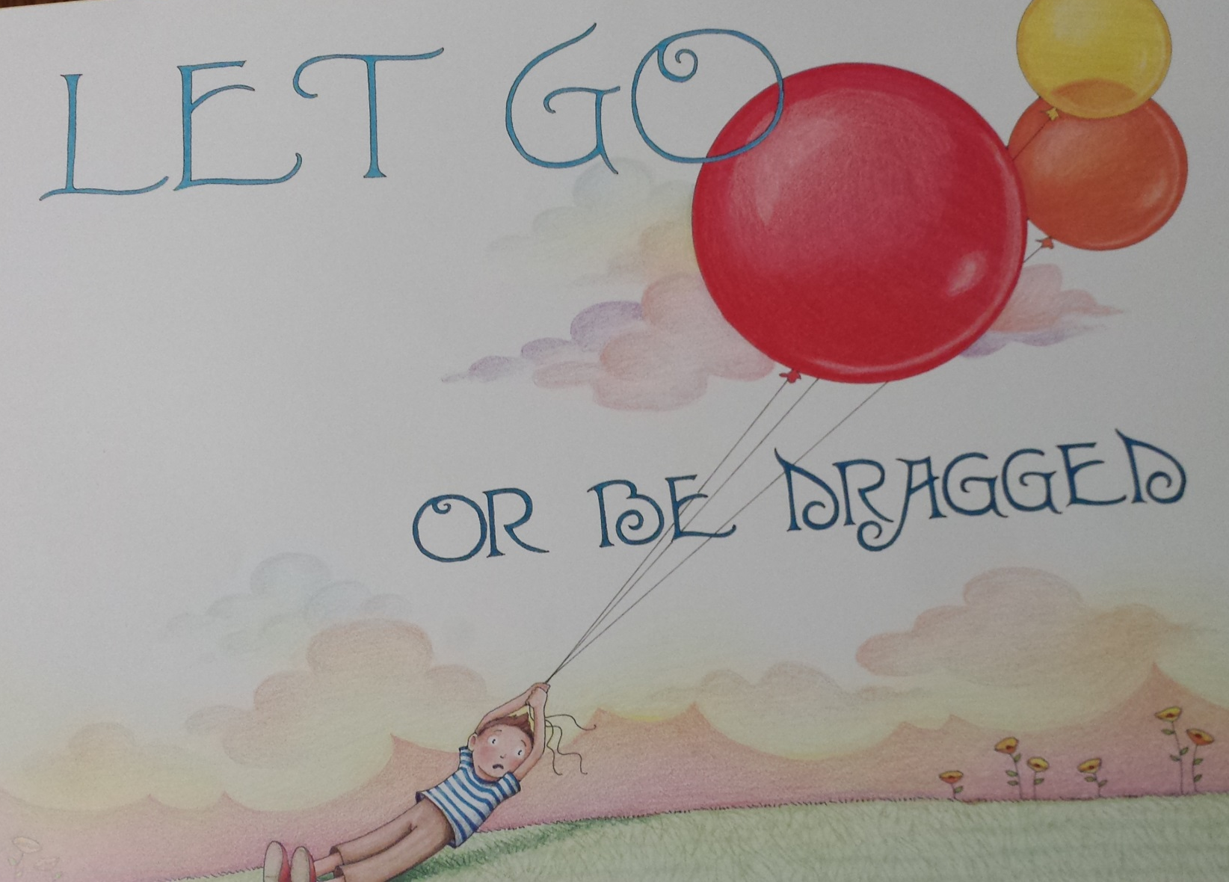
Complete Four A’s Activity

Slide 28
Counter Your Stress
Meditation/Relaxation
  Learn how to breathe
Build positive experiences in your life
Research support for many kinds of anti-stress activities
  Connecting with others - Laughter
  Emotional sharing - Music
  Pets

Slide 29

Suggestions for Reducing Stress
1. Find a support system. Find someone to talk to about your feelings and experiences.
Notes:
Speak to friends, family, a teacher, a minister, or a counselor. Sometimes we just need to "vent" or get something "off our chest." Expressing our feelings can be relieving, we can feel supported by others, and it can help us work out our problems.

Slide 30
Suggestions for Reducing Stress
2. Change your attitude. Find other ways to think about stressful situations.
  "Life is 10% what happens to us, and 90% how we react to it."
Notes:
Talk to yourself positively. Remember, "I can handle it, " "this will be over soon," or "I have handled difficult things before, and I can do it again." Also, practice acceptance. We need to learn to accept things we cannot change without trying to exert more control over them.

Slide 31
Suggestions for Reducing Stress
3. Be realistic. Set practical goals for dealing with situations and solving problems.
  Develop realistic expectations of yourself and others.
Notes:
Setting our expectations or goals high may seem like a useful way to push ourselves and get things done, but we may also set ourselves up for disappointment and continued stress. Find the courage to recognize your limits

Slide 32
Suggestions for Reducing Stress
4. Get organized and take charge. Being unorganized or engaging in poor planning often leads to frustration or crisis situations, which most always leads to feeling stressed.
  Plan your time, make a schedule, establish your priorities.
Notes:
Do this regularly until it becomes a productive habit. Take responsibility for your life. Be proactive. Problem solve and look for solutions rather than worry.

Slide 33
Suggestions for Reducing Stress
5. Take breaks, give yourself "me time." Learn that taking time to yourself for rejuvenation and relaxation is just as important as giving time to other activities.
  At minimum, take short breaks during your busy day.
Notes:
You might purposely schedule time in your day planner just for yourself so that you can recharge for all the other things you need to do. Learn your "red flags" for stress, and be willing to take time to do something about it.

Slide 34

Suggestions for Reducing Stress
6. Take good care of yourself.
Eat properly, get regular rest, keep a routine.
Allow yourself to do something you enjoy each day.
  Ironically, the time we need to take care of ourselves the most, when we are stressed, is the time we do it the least.
Notes:
When we feel overwhelmed we tend to eat poorly, sleep less, stop exercising, and generally push ourselves harder. This can tax the immune system and cause us to become ill more easily. If we take good care of ourselves to begin with, we will be better prepared to manage stress and accomplish our tasks in the long run.

Slide 35
Suggestions for Reducing Stress
7. Learn to say "no." Learn to pick and choose which things you will say "yes" to and which things you will not.
  Protect yourself by not allowing yourself to take on every request or opportunity that comes your way.
Notes:
It is okay to decline a request for a favor. Saying "no" does not mean you are bad, self-centered, or uncaring. Learn skills of assertiveness so that you can feel more confident and have effective ways of saying "no."

Slide 36

Suggestions for Reducing Stress
8. Get regular exercise. Exercising regularly can help relieve some symptoms of depression and stress, and help us to maintain our health.
Notes:
Exercise can build confidence, self-esteem, and self-image.
It is also a great way to take time for yourself, blow off steam, and release physical tension.

Slide 37
Alter the Sensations in
Your Body
Slow your breathing down with diaphragm breathing
  Increases oxygen you take in
  Slows down your heartrate too
  Stimulates vagus nerve, which can shut off cortisol
Relax your muscles with progressive muscle relaxation
  https://caps.byu.edu/relaxation-recordings
  http://www.dartmouth.edu/~healthed/relax/downloads.html
  http://www.innerhealthstudio.com/progressive-muscle-relaxation-exercise.html

Slide 38
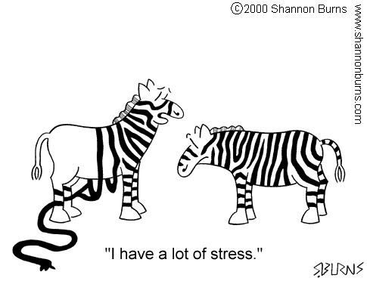
Here’s What’s Most Important

Slide 39
Here’s What’s Most Important
DON’T try to do all of these things
  That would be overwhelming
  That would make you feel more stressed
  And that’s not our goal!

Slide 40
Here’s What’s Most Important
Make one small change
  Pick what is best or easiest for you and try it
  Note any improvements in how you feel afterwards
  Feel good about your ability to make some progress
  Decide if you want/need to make another change
  Repeat

Slide 41

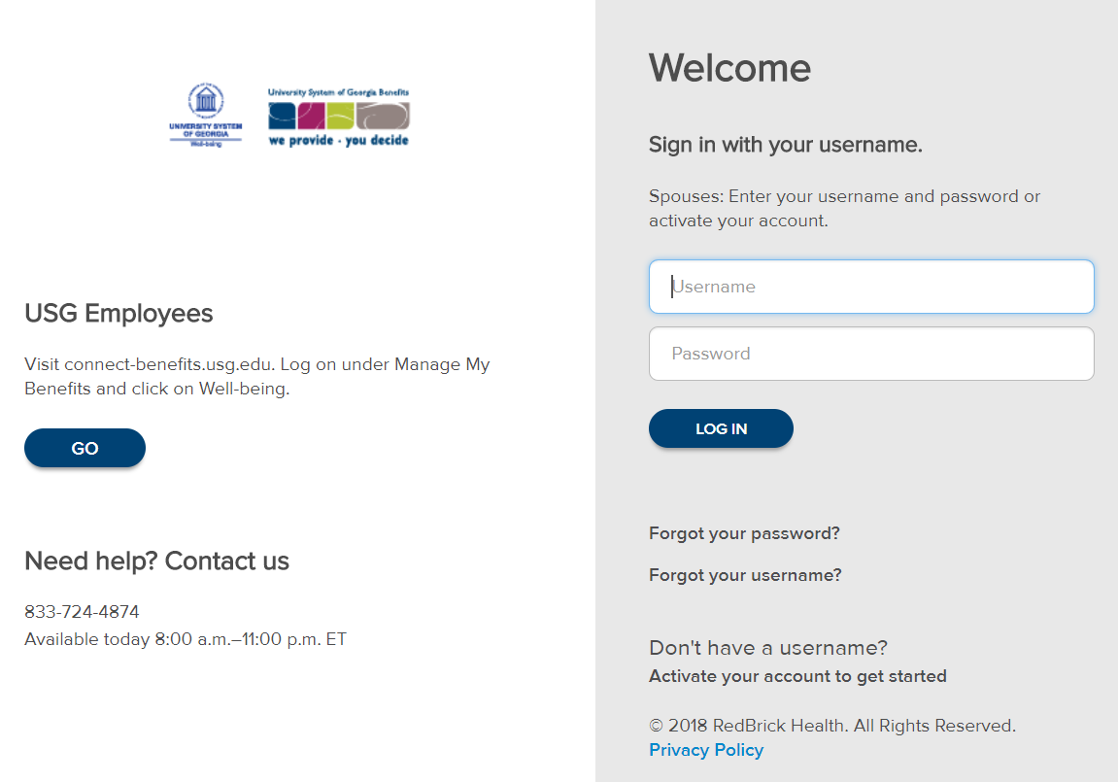
Get Started
Employees covered on a USG healthcare plan or elidgible
Visit oneusgconnect.usg.edu
  Log on under Manage My Benefits
  Click on Well-being
    How to update your contact information:
      Self-service payroll system or contact your HR office.
Covered spouses: ourwellbeing.usg.edu
  Activate your account to get started
  First name, Last name, Date of birth
  Receive verification code

Slide 42
ESPYR-Employee Assistance Program
ESPYR.com Password: USGcares
Assessments: The Resilience Scale, wellbeing assessment, perceived stress scale
A few of the many webinars: The Power of Positive Self-Talk, Minimizing Worry to Maximize Your Life and Finding Your Balance

Slide 43
Any Questions?
Thank you all for attending!
Be sure to sign in if you already have not done so, resources will be sent to you electronically.

